Slide 1
Support Vector Machine (SVM)

Slide 2

What is Support Vector Machine?
SVM is a supervised machine learning algorithm.
Used for classification and regression tasks.
Finds the optimal hyperplane to separate data into classes.

Slide 3
Key Concepts in SVM
Hyperplane: Decision boundary between classes.
Support Vectors: Data points closest to the hyperplane.
Margin: Distance between hyperplane and nearest data point.

Slide 4
Linear SVM
Works when data is linearly separable.
Goal: Maximize margin between classes.
Uses a straight line (or hyperplane in higher dimensions).

Slide 5
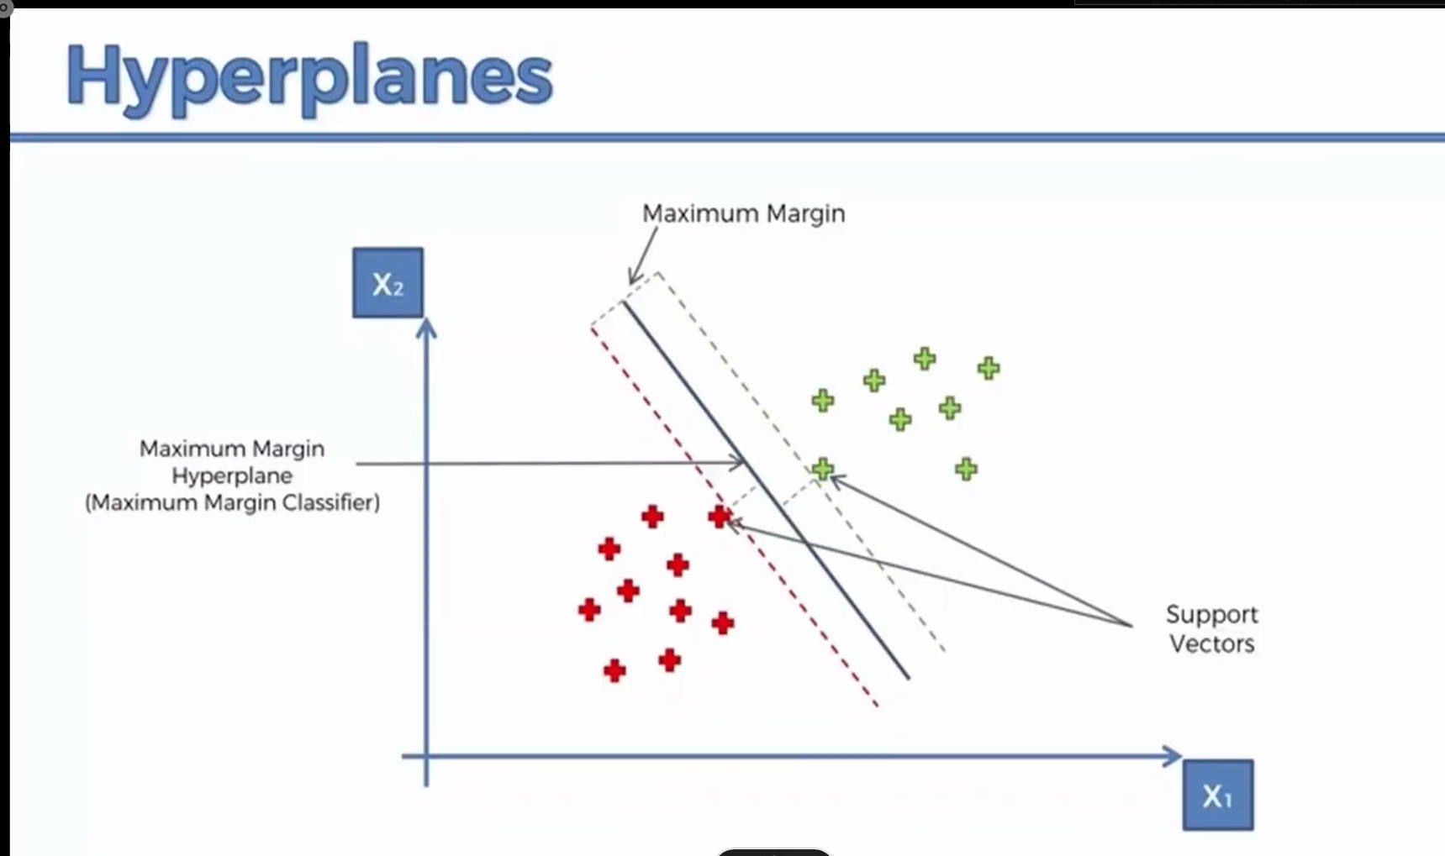
Linear SVM

Slide 6
Non-Linear SVM
Real-world data is often non-linearly separable.
Uses kernel functions to map data to higher dimensions.
Common kernels: Polynomial, RBF (Gaussian), Sigmoid.

Slide 7
The Kernel Trick
Converts non-linear data to linear by mapping it to higher dimensions.
Avoids computing high-dimensional coordinates explicitly.
Efficient and powerful.

Slide 8
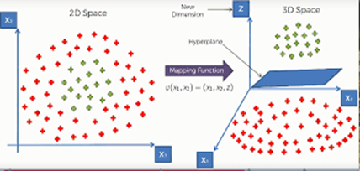
Kernel trick : higher dimension

Slide 9
Applications of SVM
Image recognition
Spam detection
Bioinformatics
Text categorization
Stock market prediction

Slide 10
Applications of SVM in ADAS
Lane Detection: Classifies road boundaries and lane markings from camera inputs.
Pedestrian Detection: Identifies pedestrians using real-time image classification.
Traffic Sign Recognition: Classifies traffic signs using visual features and SVM classifiers.
Driver Drowsiness Detection: Detects drowsiness via facial landmarks and eye behavior.
Obstacle Recognition: Differentiates between vehicles, animals, and other objects in driving paths.

Slide 11
Pros and Cons of SVM
Pros:
Works well with high-dimensional data
Effective with clear margin of separation
Robust against overfitting (in high dimensions)
Cons:
Not suitable for large datasets
Difficult to choose the right kernel
Training can be slow

Slide 12
Conclusion
SVM is a powerful tool for classification.
Kernel trick allows handling complex data.
Choosing the right kernel and parameters is key.

